Slide 1


MOVIE RECOMMENDATION SYSTEM
MACHINE LEARNING PROJECT
SUBMITTED BY:
ROJALIN PARIDA
ANWESHA RATH
I PRASANTI
GUIDED BY:
MR. NAYAN RANJAN PAUL
This Photo by Unknown Author is licensed under CC BY-SA-NC

Slide 2
contents
Introduction
Project overview
Datasets
Importing datasets
Sparsity of user-item matrix
Rating count
Data graphs
Result analysis
Conclusion

Slide 3
introduction
Recommendation systems are becoming increasingly important in today’s hectic world. People are always in the lookout for products/services that are best suited for them. Therefore, the recommendation systems are important as they help them make the right choices, without having to expend their cognitive resources.
Recommendation systems can be broadly classified into 3 types :
Collaborative Filtering
Content-Based Filtering
Hybrid Recommendation Systems

Slide 4
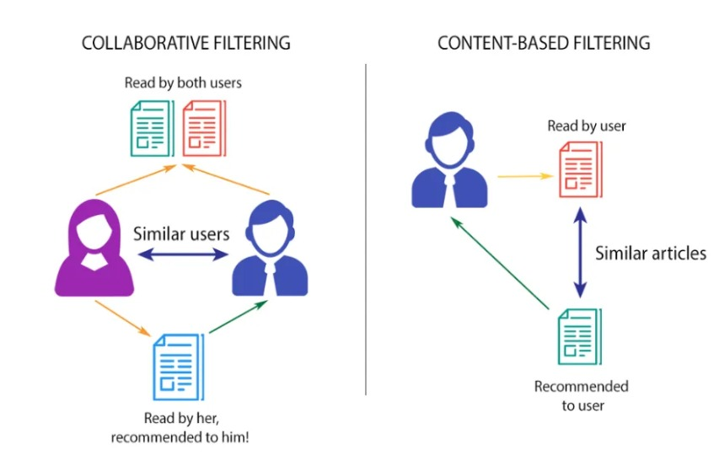
Collaborative Filtering
This filtering method is usually based on collecting and analyzing information on user’s behaviors, their activities or preferences, and predicting what they will like based on the similarity with other users. A key advantage of the collaborative filtering approach is that it does not rely on machine analyzable content and thus it is capable of accurately recommending complex items such as movies without requiring an “understanding” of the item itself.

Slide 5
TYPES OF COLLABORATIVE FILTERING
User-User Collaborative Filtering:
Try to search for lookalike customers and offer products based on what his/her lookalike has chosen.
Item-Item Collaborative Filtering:
It is very similar to the previous algorithm, but instead of finding a customer lookalike, we try finding item lookalike. Once we have item lookalike matrix, we can easily recommend alike items to a customer who has purchased an item from the store.

Slide 6
ITEM BASED RECOMMENDATION SYSTEM
Collaborative filtering based systems uses the actions of users to recommend other items. In general, they can either be user based or item based. User based collaborating filtering uses the patterns of users similar to us to recommend a product. Item based collaborative filtering uses the patterns of users who browsed the same item as us to recommend a product (users who looked at our item also looked at these other items). Item-based approach is usually preferred than user-based approach. User-based approach is often harder to scale because of the dynamic nature of users, whereas items usually don't change much, so item-based approach often can be computed offline.
In this recommender system , items will be clustered based on rating of item given by users and item will be recommended based on similar items.
Here we are going to use an unsupervised learning algorithm known as Nearest Neighbors(KNN). So we have to reshape/prepare our dataset into a format which can be given as parameter. We will pivot our final dataset into a ITEM-USER matrix and empty cell with 0.

Slide 7
Content-BASED Filtering
These filtering methods are based on the description of an item and a profile of the user’s preferred choices. In a content-based recommendation system, keywords are used to describe the items, besides, a user profile is built to state the type of item this user likes. In other words, the algorithms try to recommend products that are similar to the ones that a user has liked in the past.

Slide 8
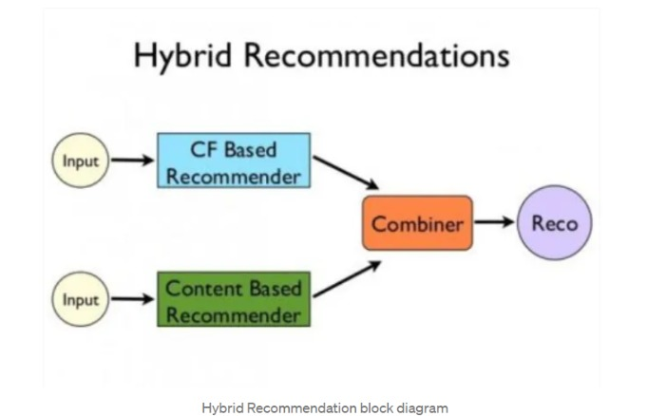
hybrid Filtering
Recent research has demonstrated that a hybrid approach, combining collaborative filtering and content-based filtering could be more effective in some cases. Hybrid approaches can be implemented in several ways, by making content-based and collaborative-based predictions separately and then combining them, by adding content-based capabilities to a collaborative-based approach (and vice versa), or by unifying the approaches into one model.

Slide 9
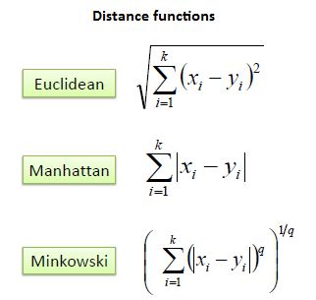
K-NEAREST NEIGHBORs ALGORITHM
KNN (k-nearest neighbors) is a supervised machine learning algorithm used for classification and regression tasks. It is a non-parametric algorithm that makes predictions based on the k-nearest data points in the training set. In KNN, a data point is classified or predicted based on the class or value of its k-nearest neighbors.
KNN is a simple and easy-to-implement algorithm, and it is often used as a baseline for more complex machine learning models.

Slide 10
DATASETS
The dataset used in this context is downloaded from MovieLens and saved to working directory.
1) movies.csv : this file contain movieId, title of movies and genre of movies.
2) ratings.csv : this file contain ratings given by userId to MovieId and rating given to movieId.
This dataset contain 9000 unique movies and 600 unique user . Total ratings in this dataset is around 300,000.
To read the contents of the file the Pandas library’s ‘read_csv()’ function is used. This function takes the file path as input and returns a Pandas Dataframe containing the contents of csv file.

Slide 11
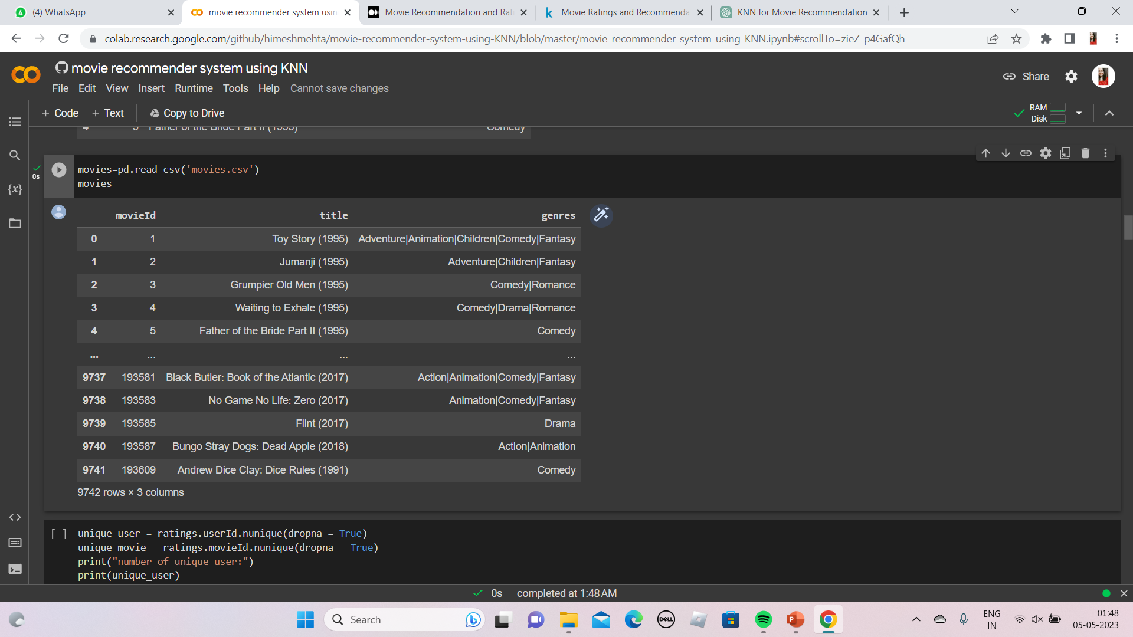
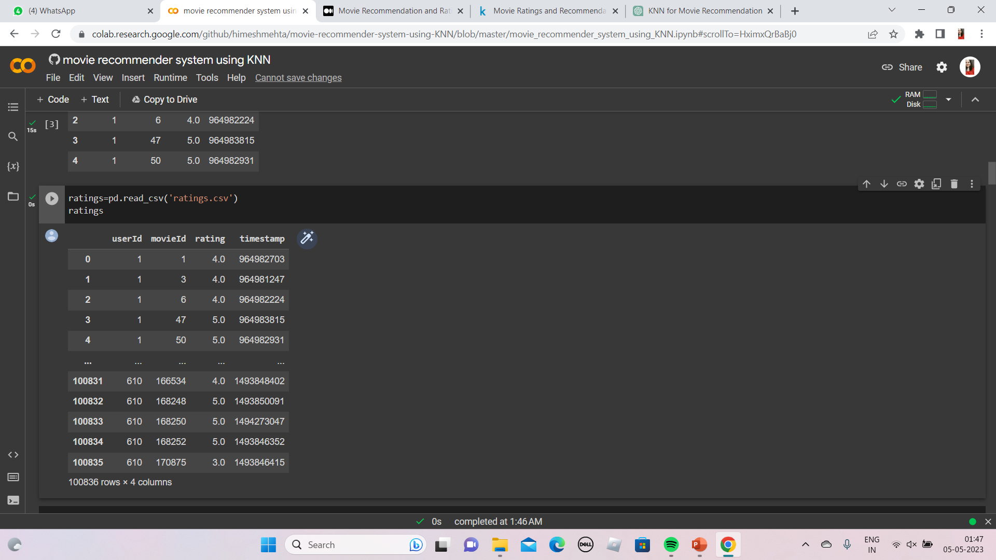
Importing dataset
movies.csv
ratings.csv

Slide 12

Sparsity of user-item matrix
To check the no. of ratings present.

Slide 13
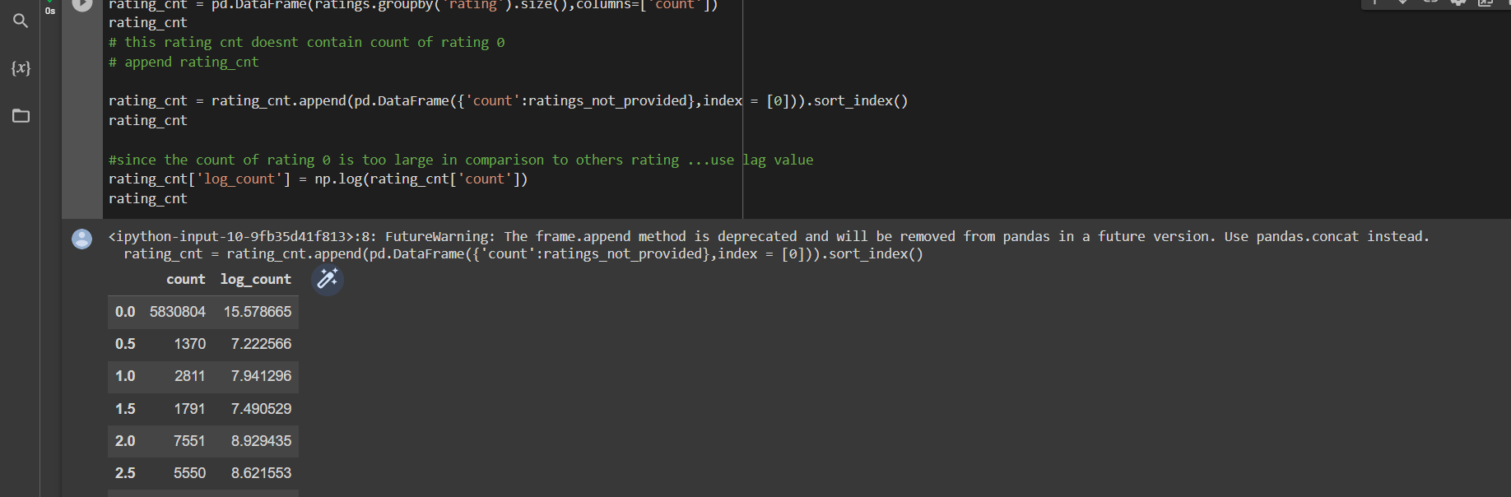
RATING COUNIt gives information about which rating(on scale) is more frequent RATING COUNT
It gives information about which rating(on scale) is more frequent

Slide 14
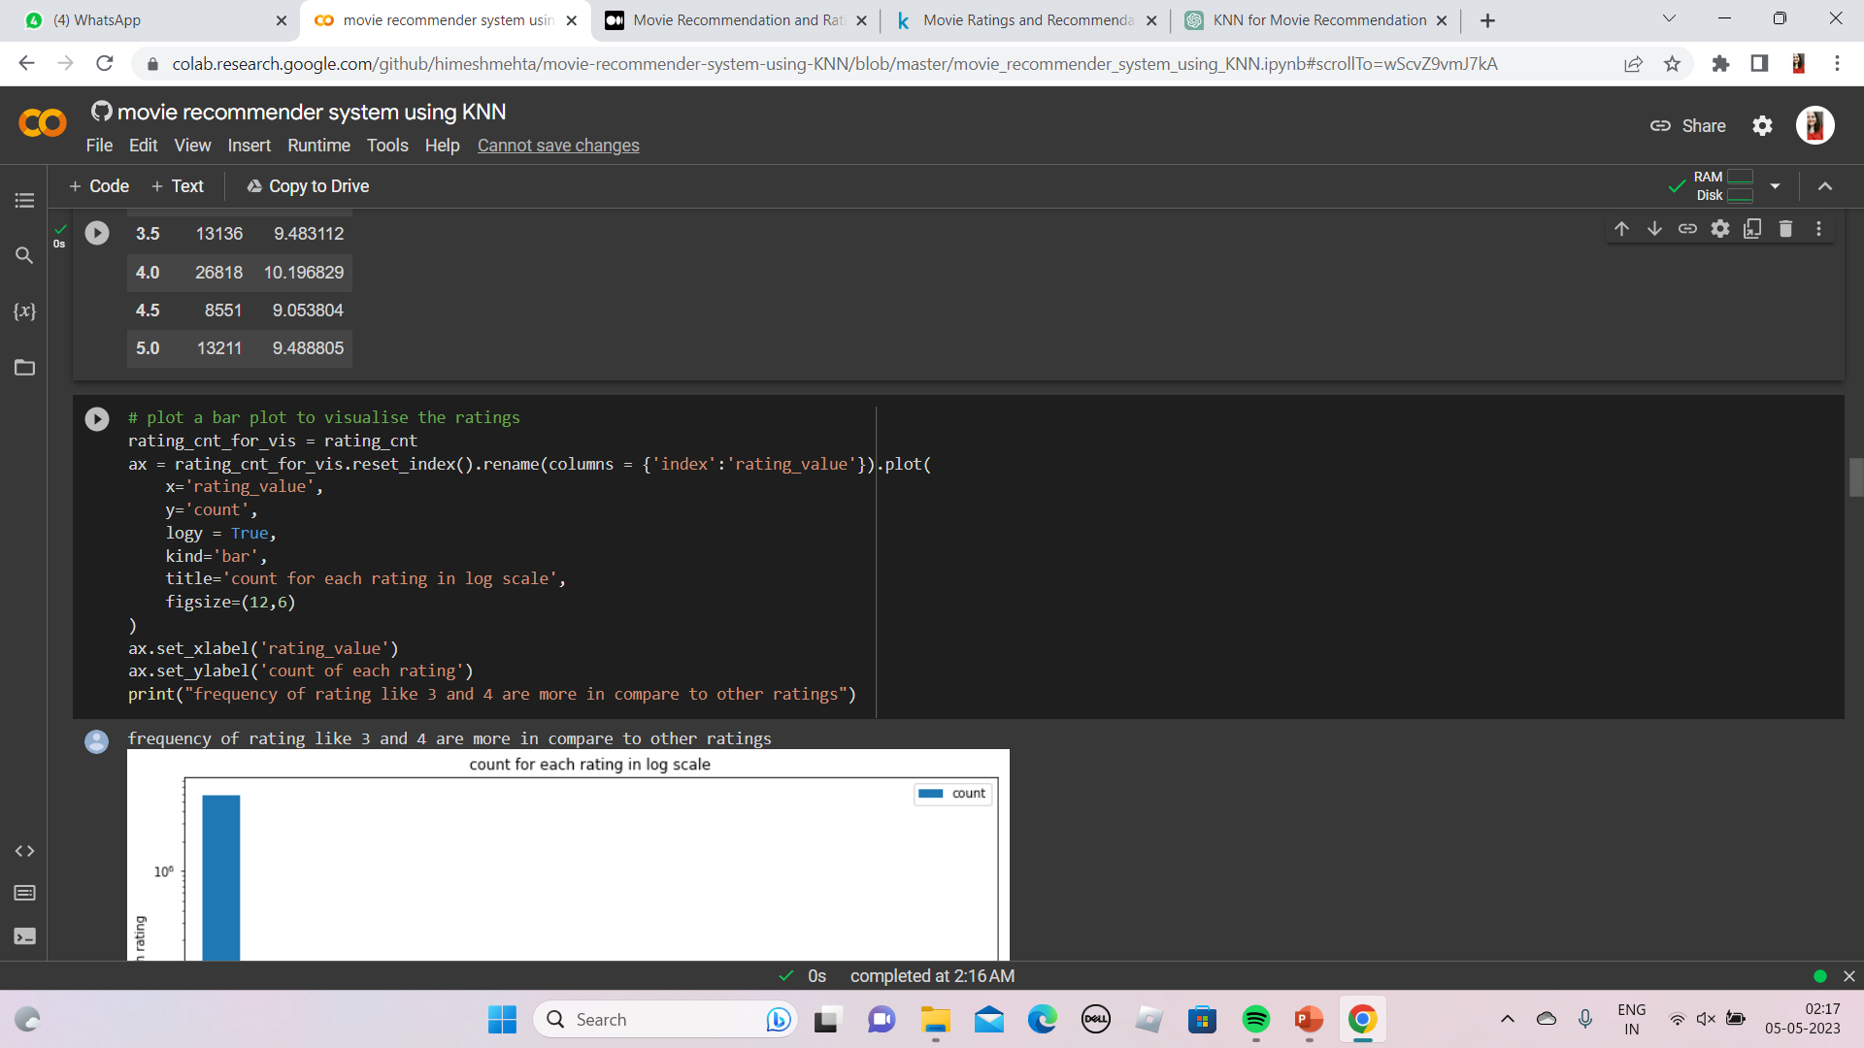
RATING COUNIt gives information about which rating(on scale) is more frequent Bar plot to visualise the ratings

Slide 15
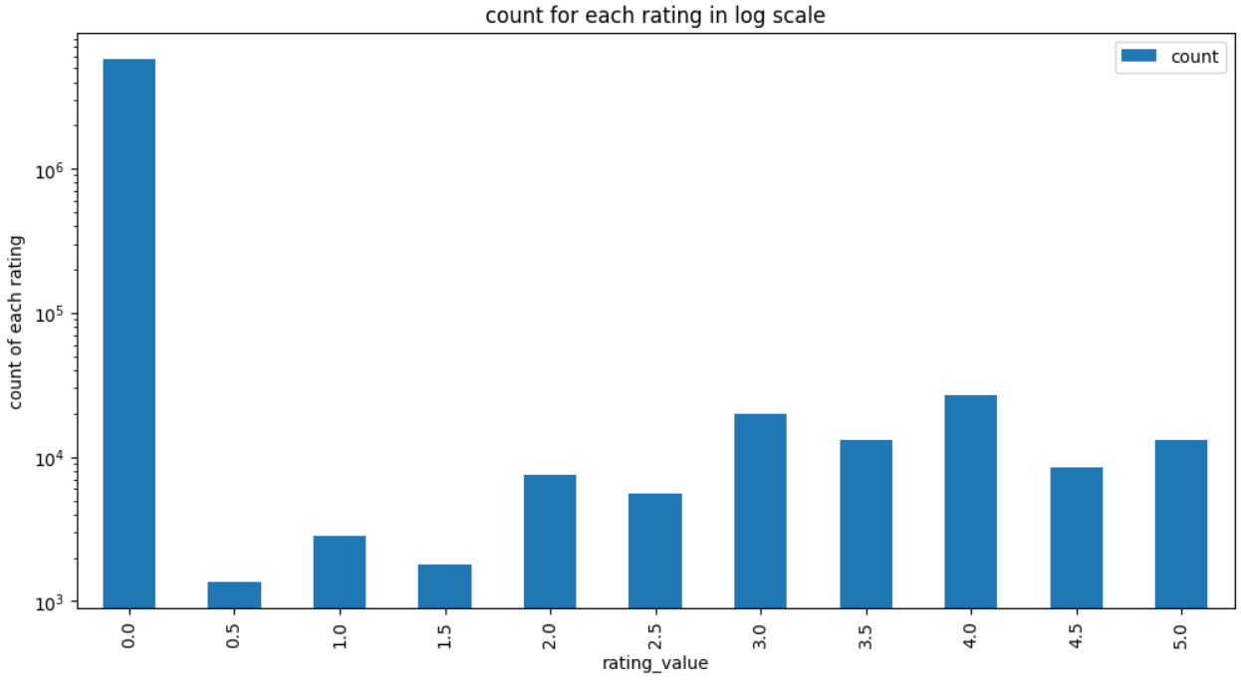

Slide 16
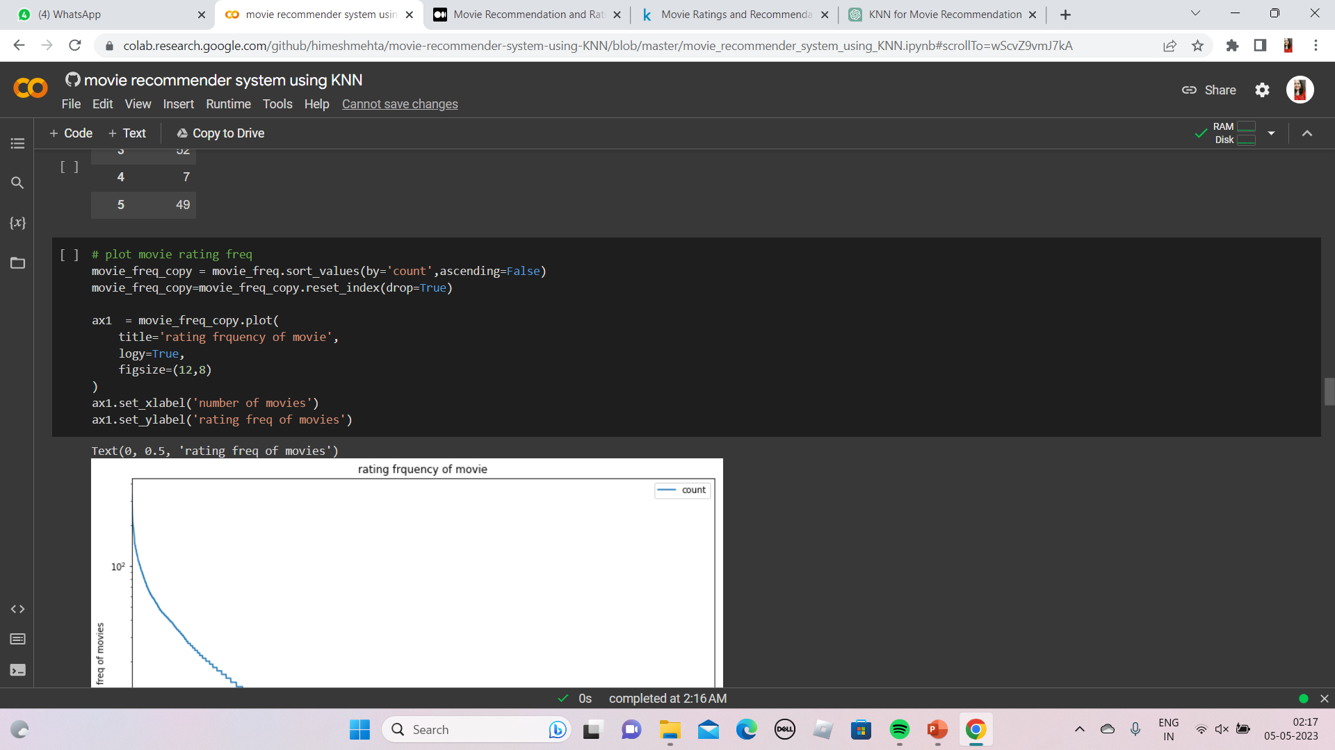
RATING COUNIt gives information about which rating(on scale) is more frequent Graph for rating frequency of movies

Slide 17
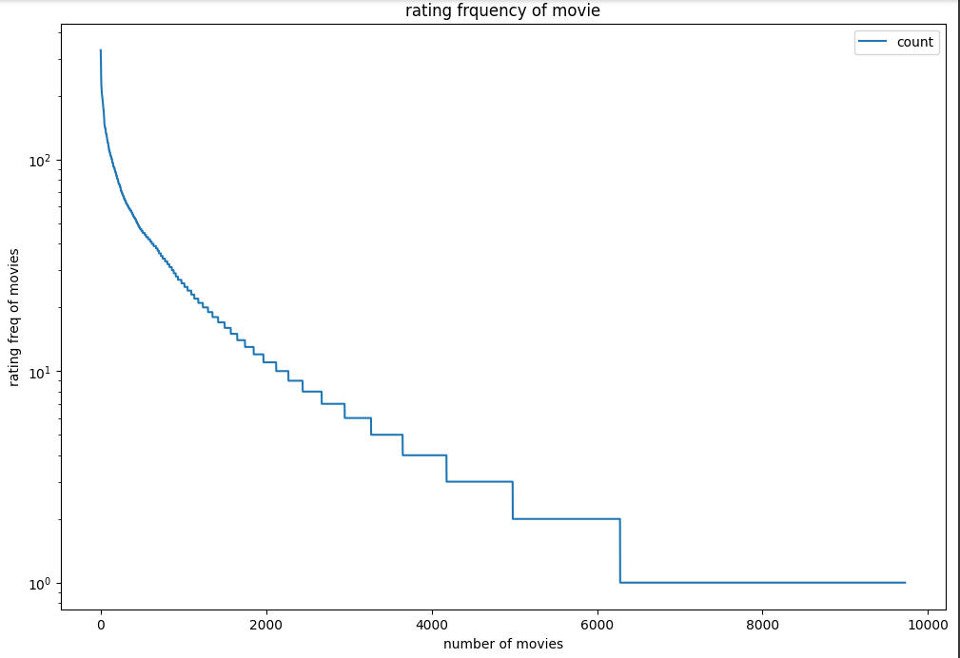

Slide 18
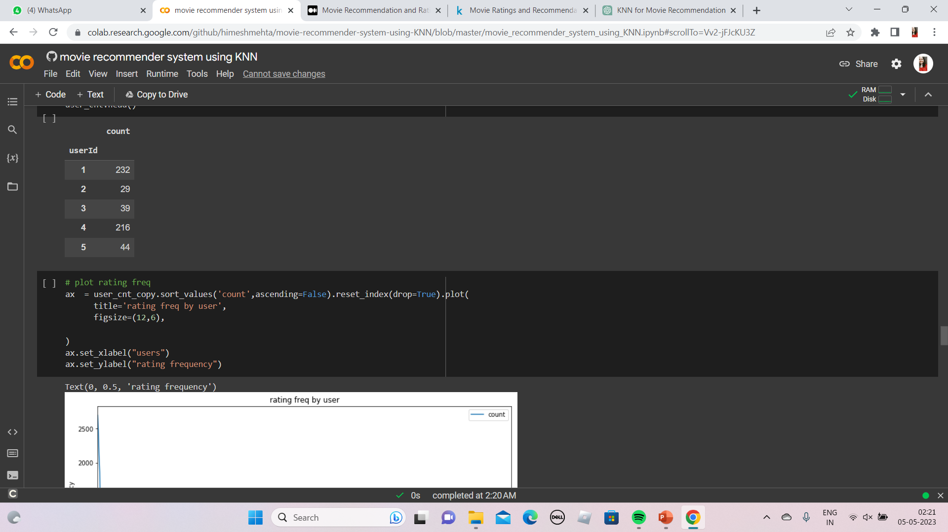
RATING COUNIt gives information about which rating(on scale) is more frequent Graph for rating frequency BY USERS

Slide 19
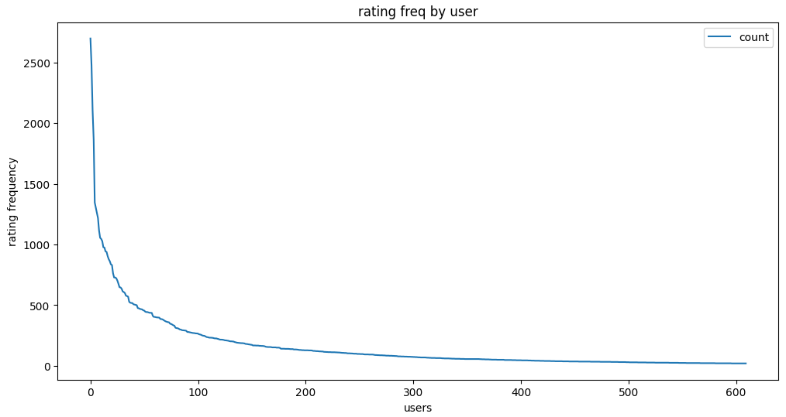

Slide 20
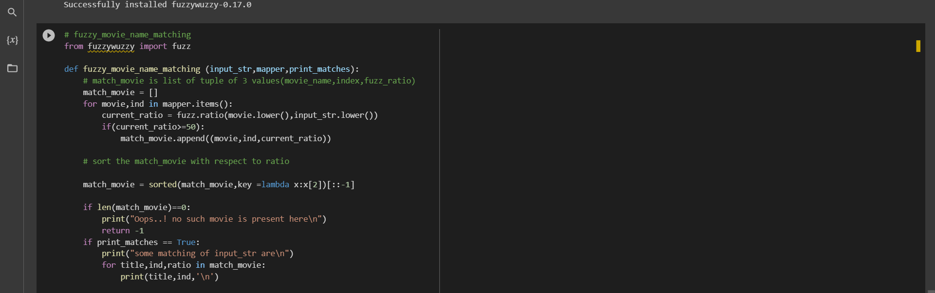
Implementation using fuzzywuzzy
For string matching we are going to use this, based on the result of fuzzy matching, a list of recommendations will be generated.

Slide 21
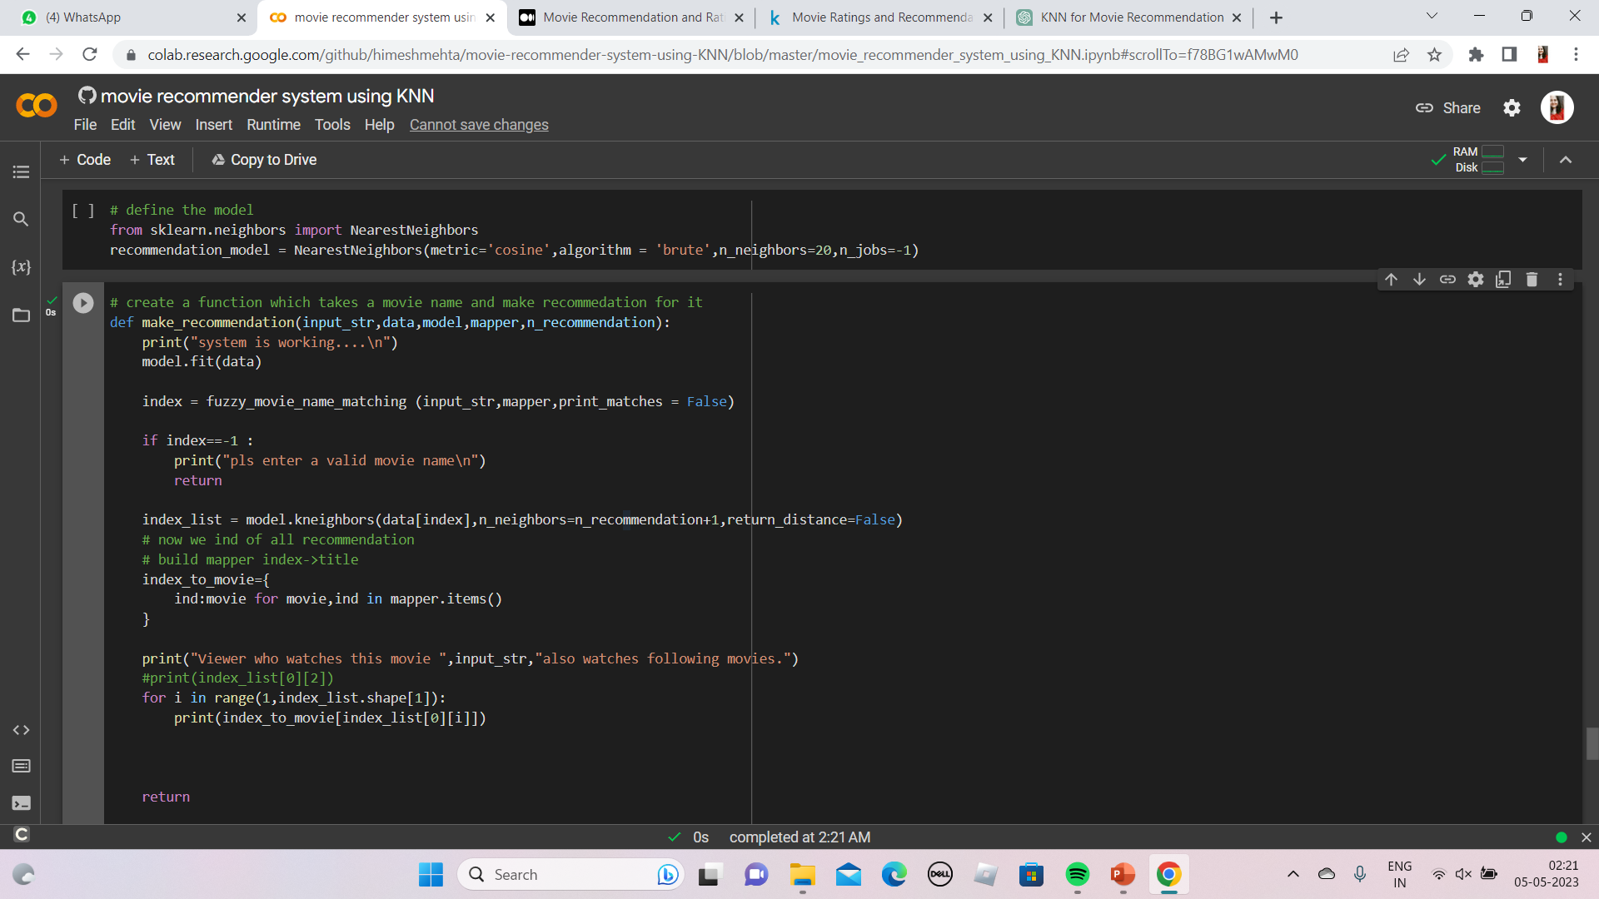
Implementing using knn
Creates a function which takes a movie name and then makes recommendations

Slide 22
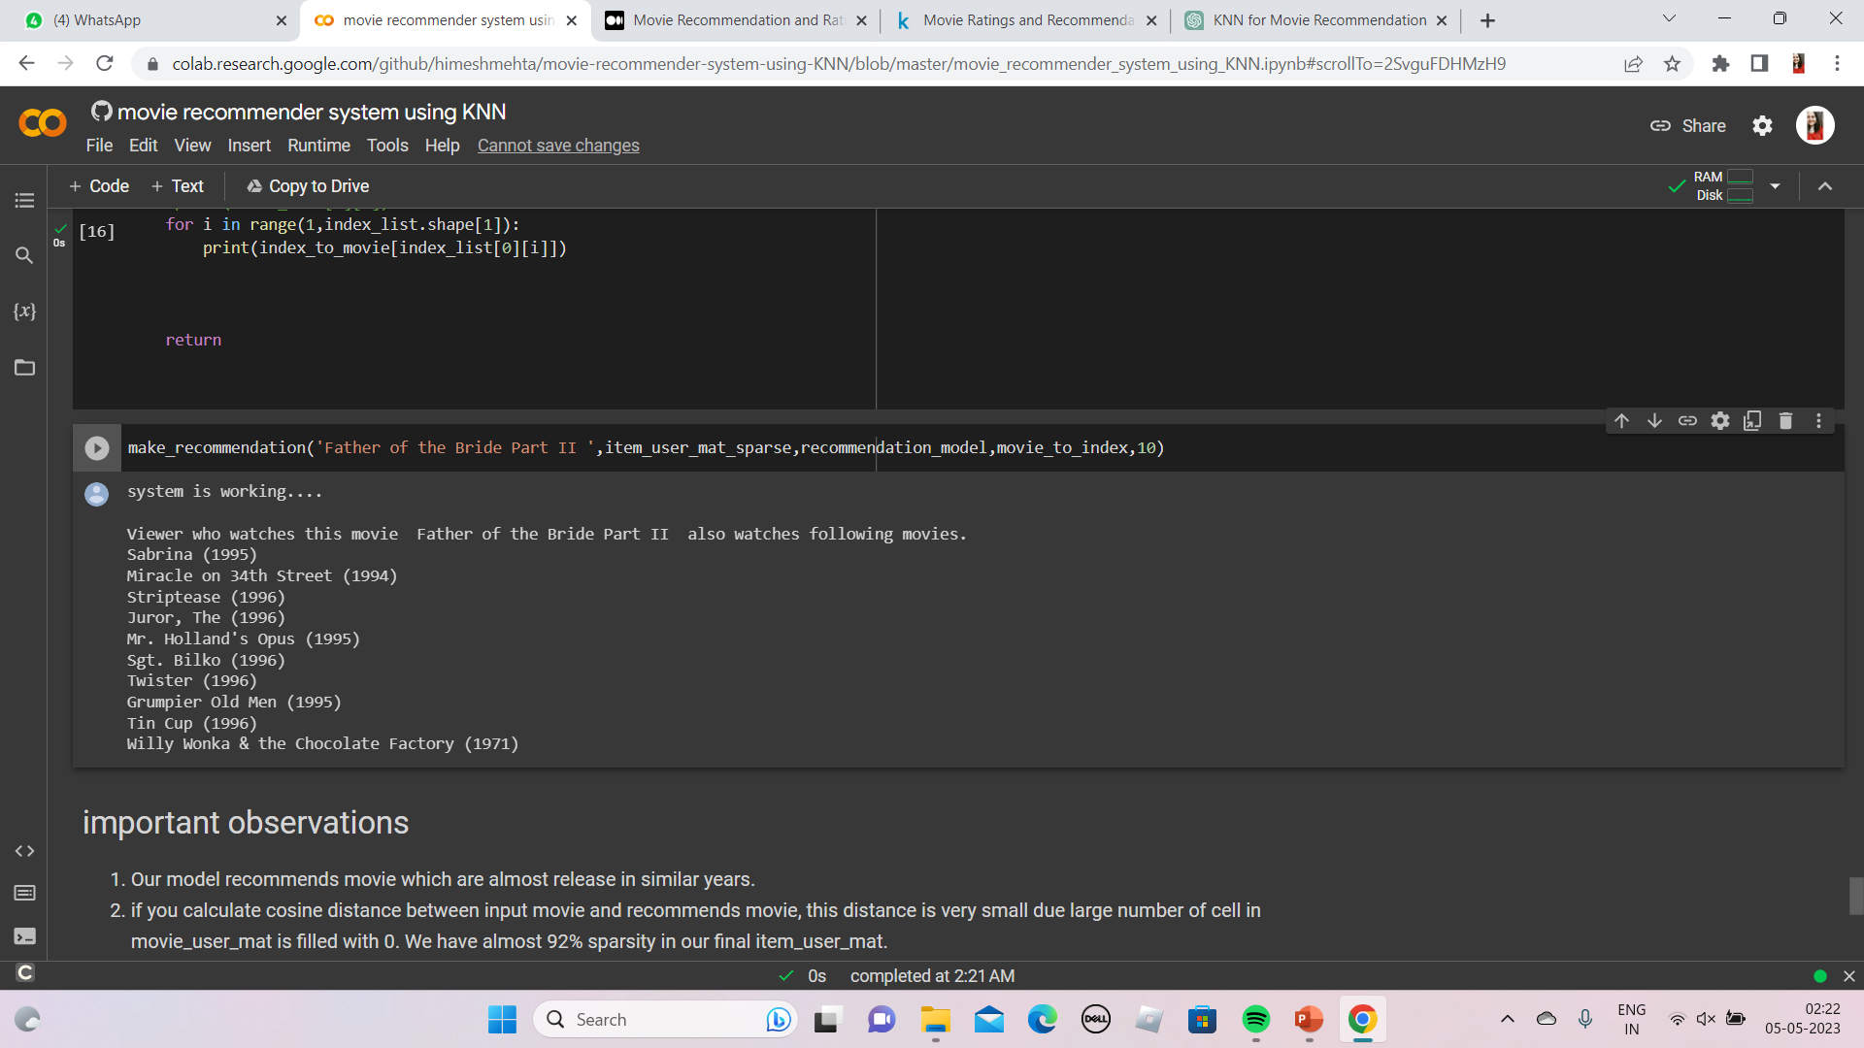
RESULT ANALYSIS
Our model recommends movie which are almost release in similar years.
Since we have removed unpopular movies from our dataset , this movie will never be recommend to user

Slide 23

DEPLOYMENT

Slide 24
CONCLUSION
In conclusion, KNN algorithm can be used effectively for movie recommendation and rating prediction tasks. By utilizing a similarity measure between users or items, KNN can identify similar users or items and make recommendations based on their ratings or preferences. Similarly, KNN can be used to predict movie ratings by finding similar users or items and calculating their average ratings.
Overall, KNN is a simple and effective algorithm that can provide valuable insights into user preferences and behavior in the context of movie recommendations and ratings.
In summary, KNN is a versatile algorithm that can be used for a wide range of tasks including movie recommendation and rating prediction. Its simplicity and interpretability make it a popular choice among practitioners and researchers.

Slide 25

THANK YOU!

